Slide 1
Algorithms
Lecture #05
Dr.Sohail Aslam

Slide 2
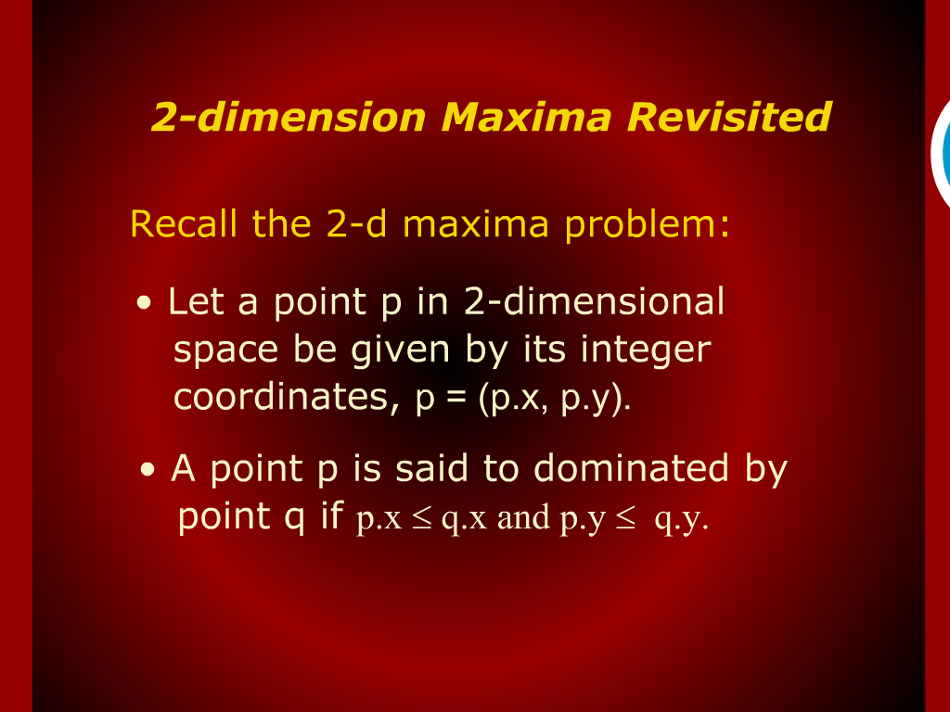
2-dimension Maxima Revisited

Slide 3
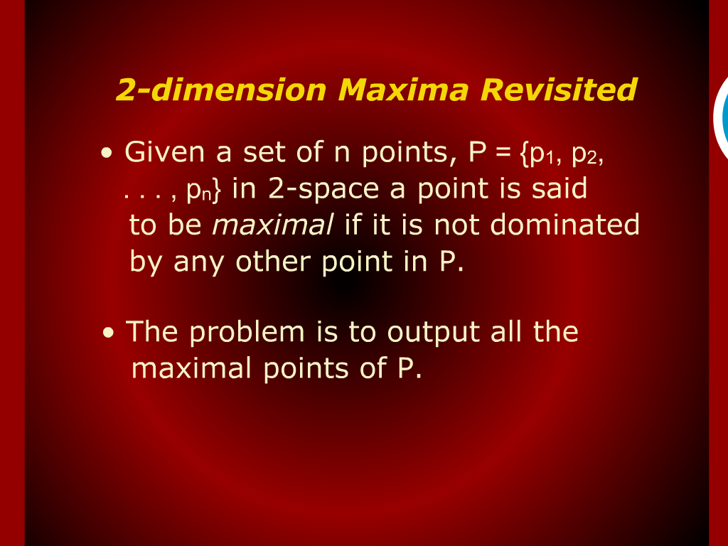
2-dimension Maxima Revisited

Slide 4
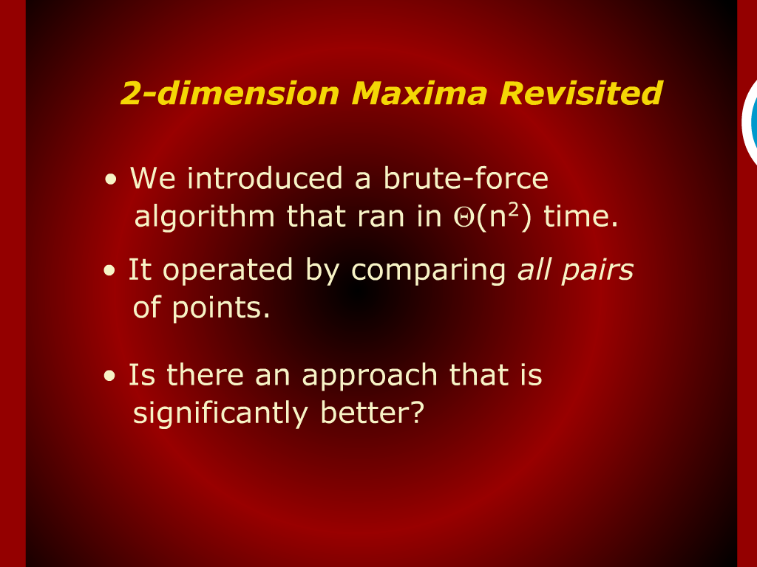
2-dimension Maxima Revisited

Slide 5
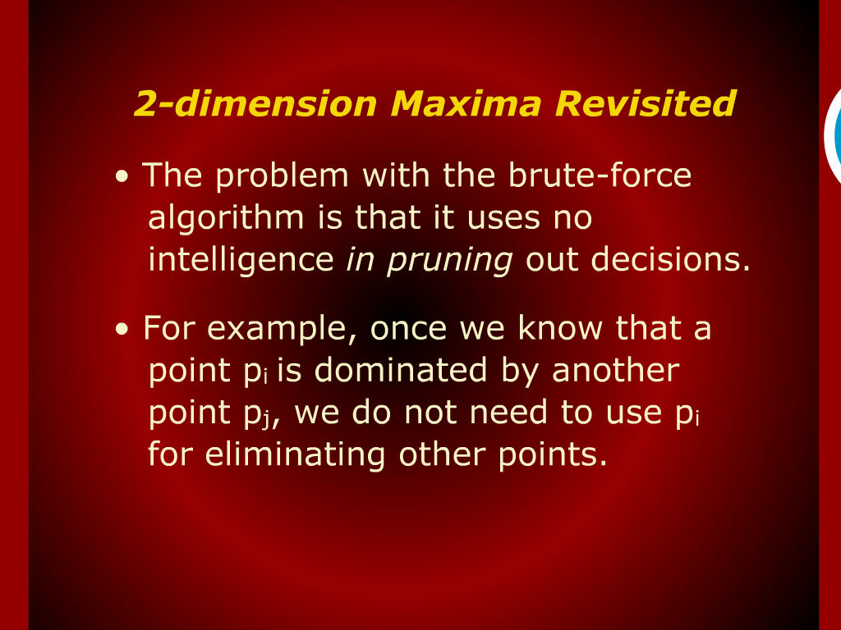
2-dimension Maxima Revisited

Slide 6
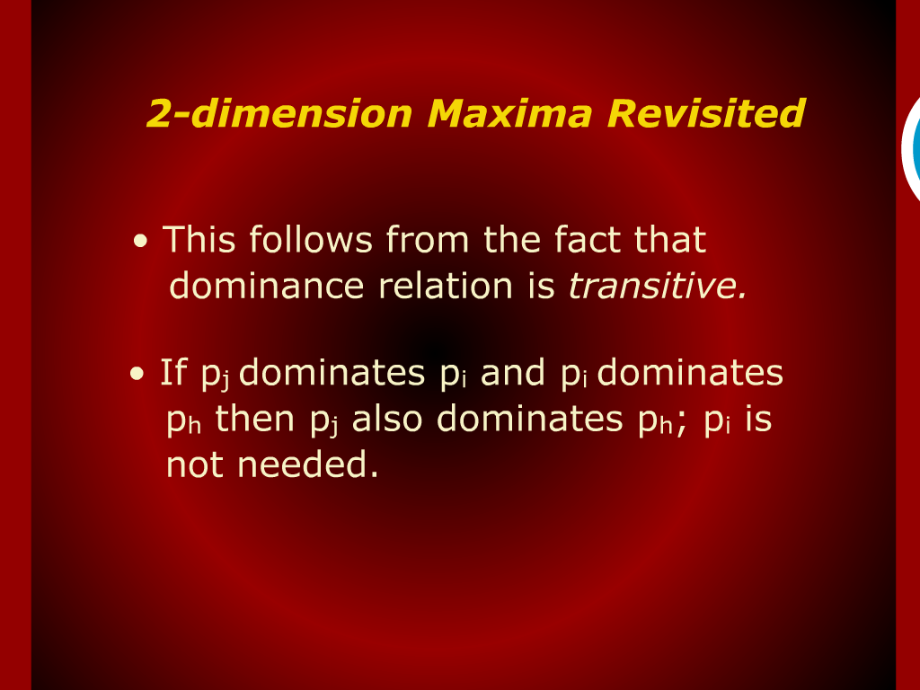
2-dimension Maxima Revisited

Slide 7
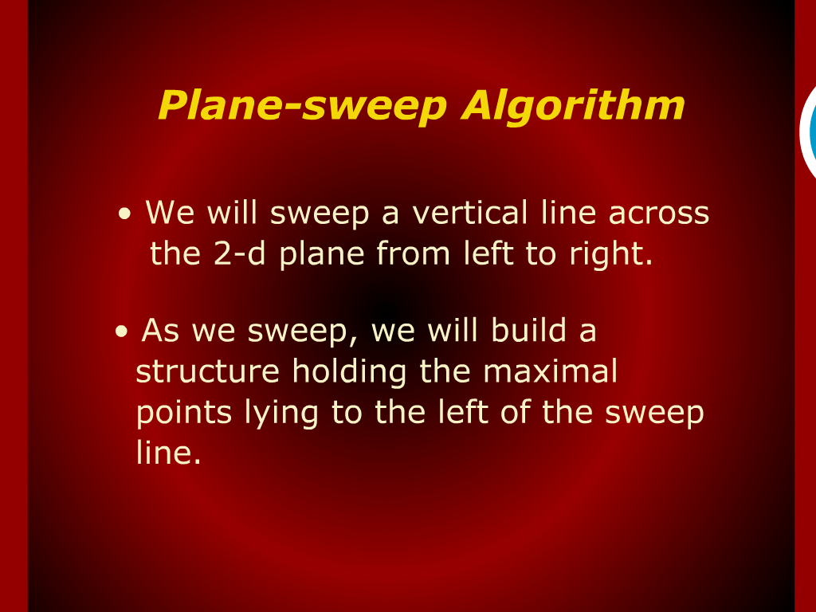
Plane-sweep Algorithm

Slide 8
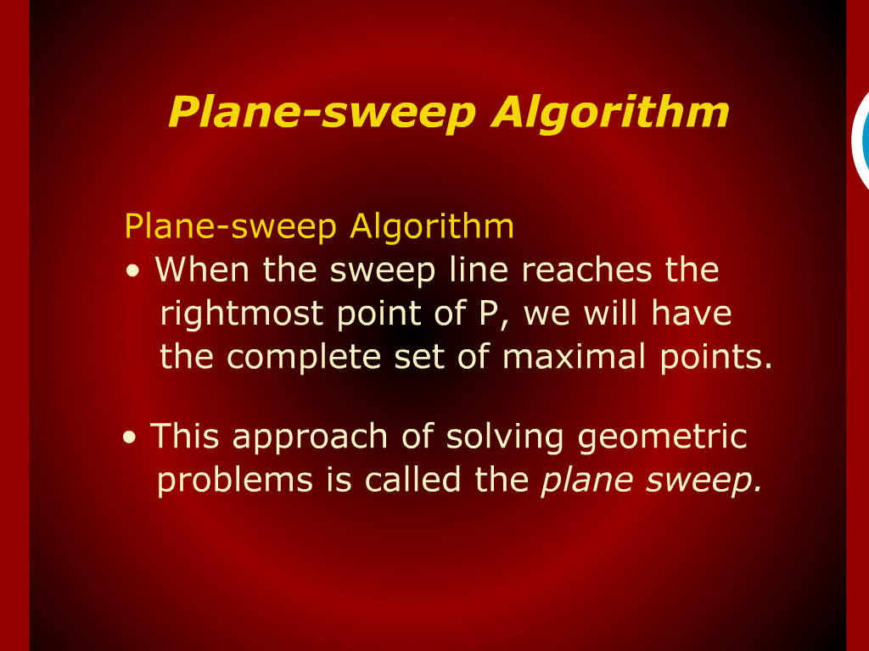
Plane-sweep Algorithm

Slide 9
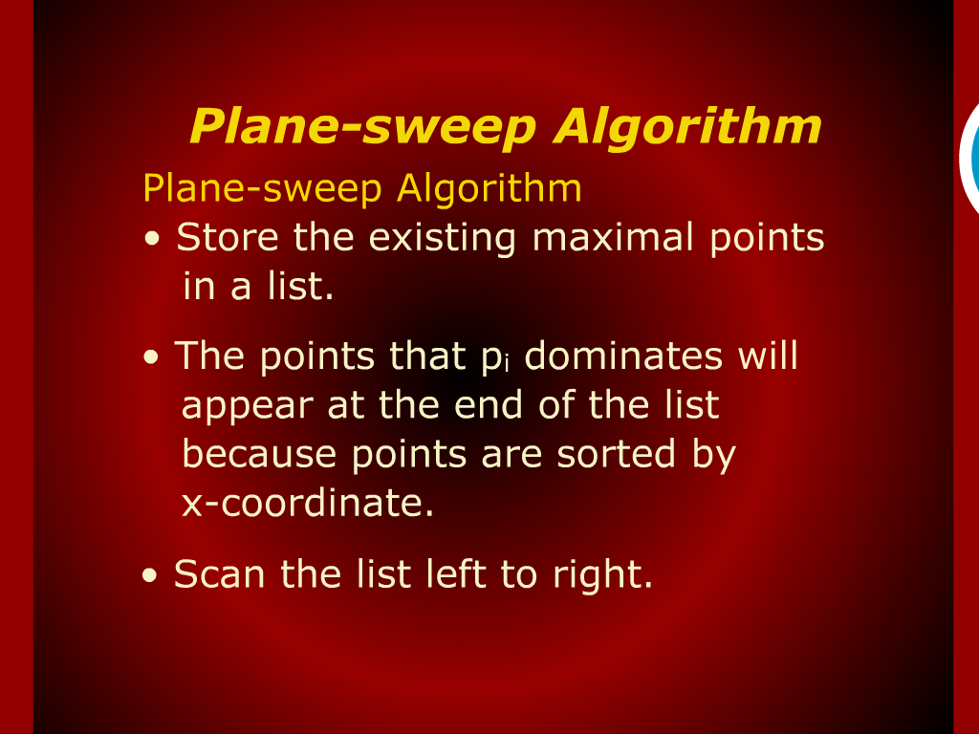
Plane-sweep Algorithm

Slide 10
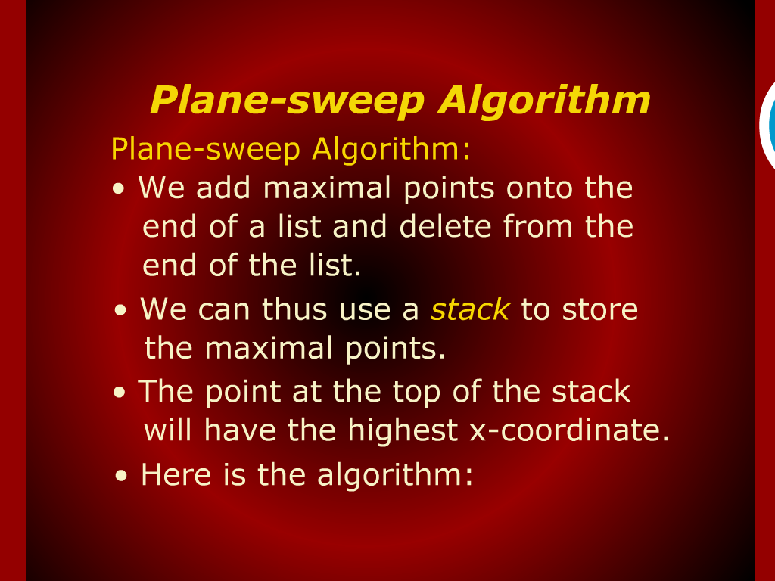
Plane-sweep Algorithm

Slide 11
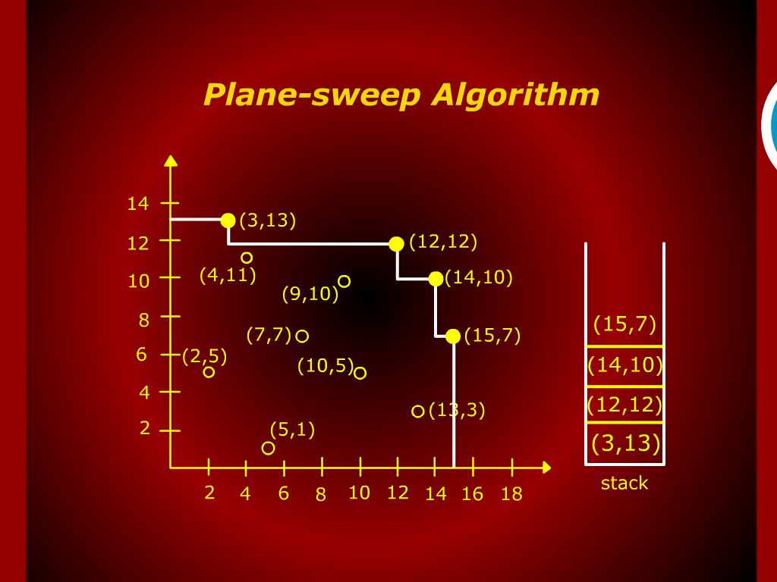
Plane-sweep Algorithm

Slide 12
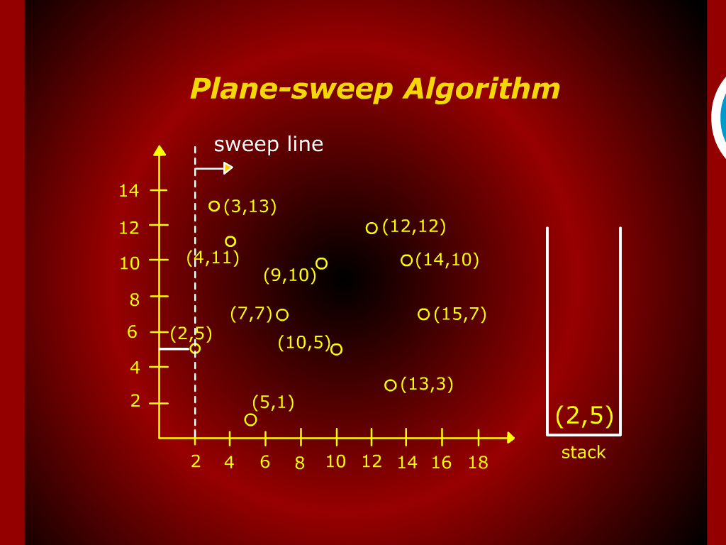
Plane-sweep Algorithm

Slide 13
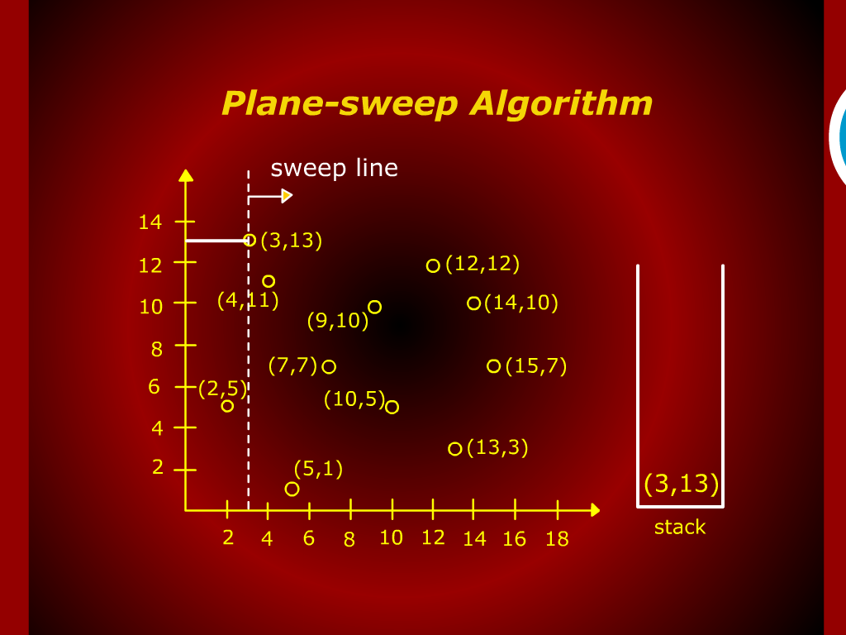
Plane-sweep Algorithm

Slide 14
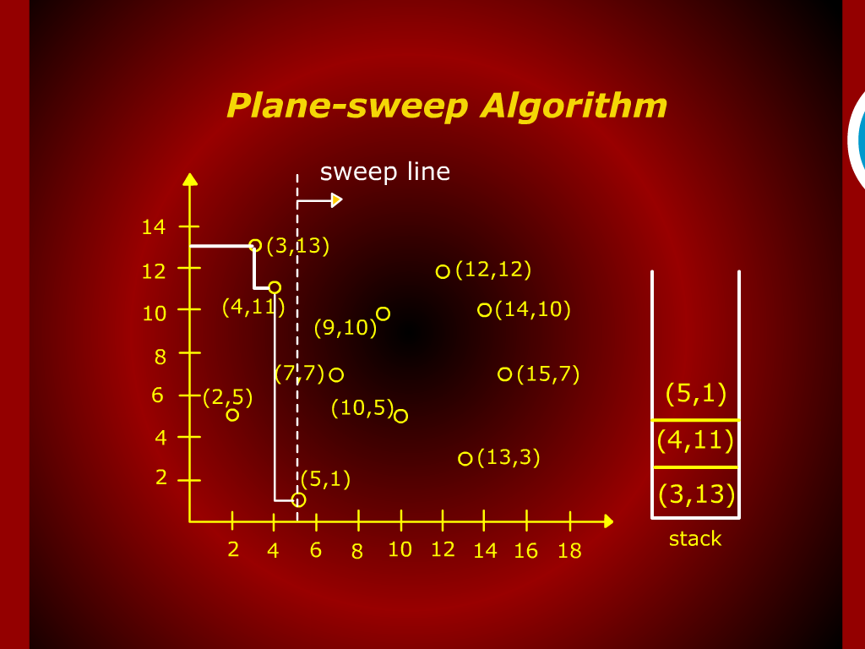
Plane-sweep Algorithm

Slide 15
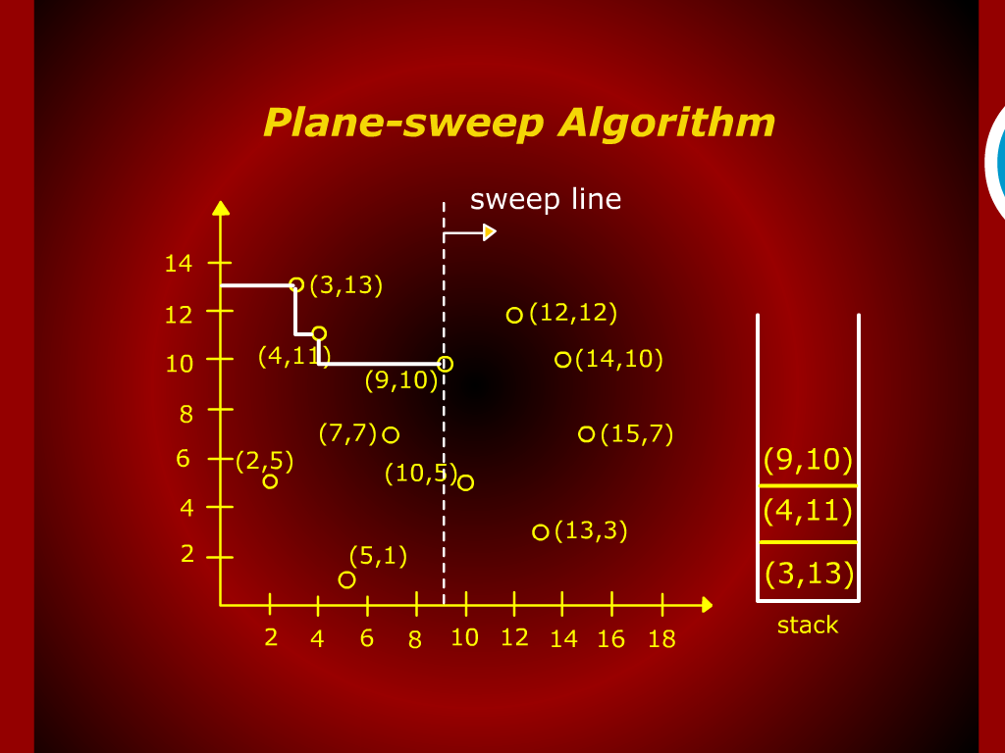
Plane-sweep Algorithm

Slide 16
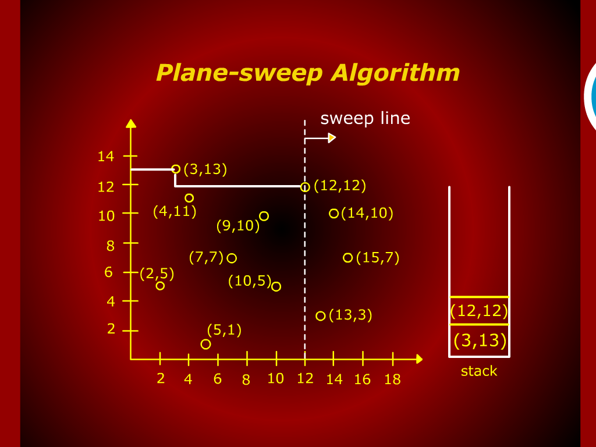
Plane-sweep Algorithm

Slide 17
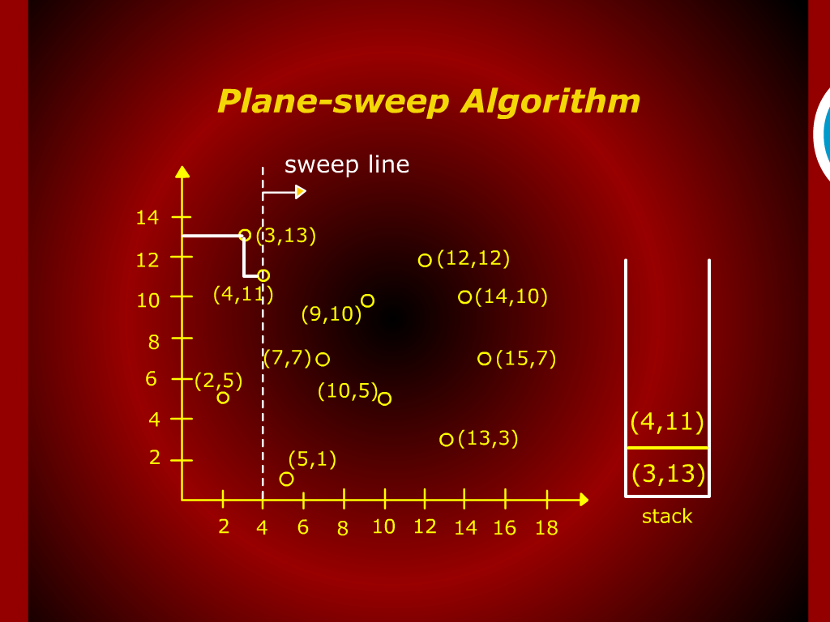
Plane-sweep Algorithm

Slide 18
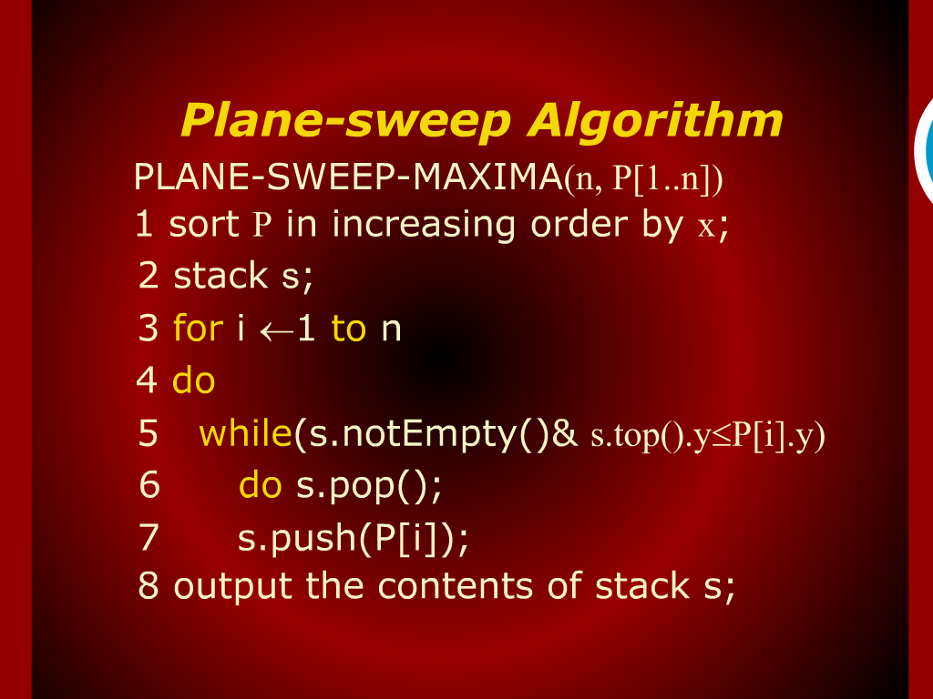
Plane-sweep Algorithm

Slide 19
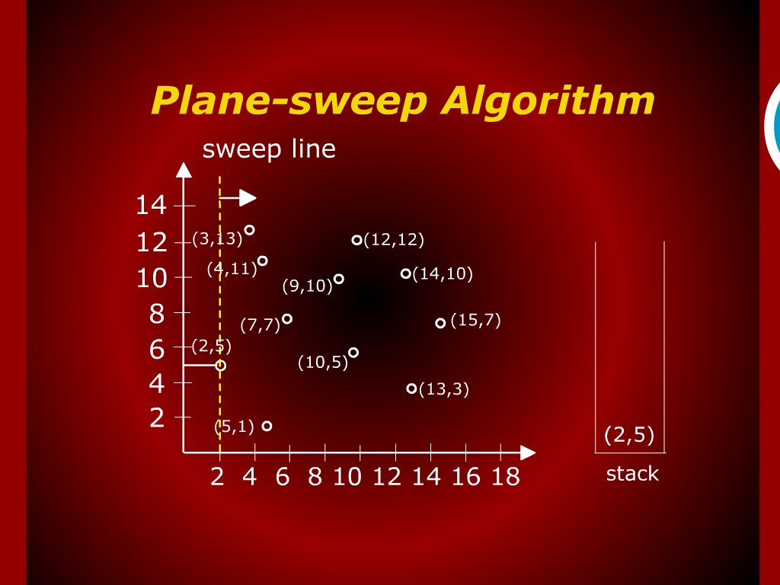
Plane-sweep Algorithm

Slide 20
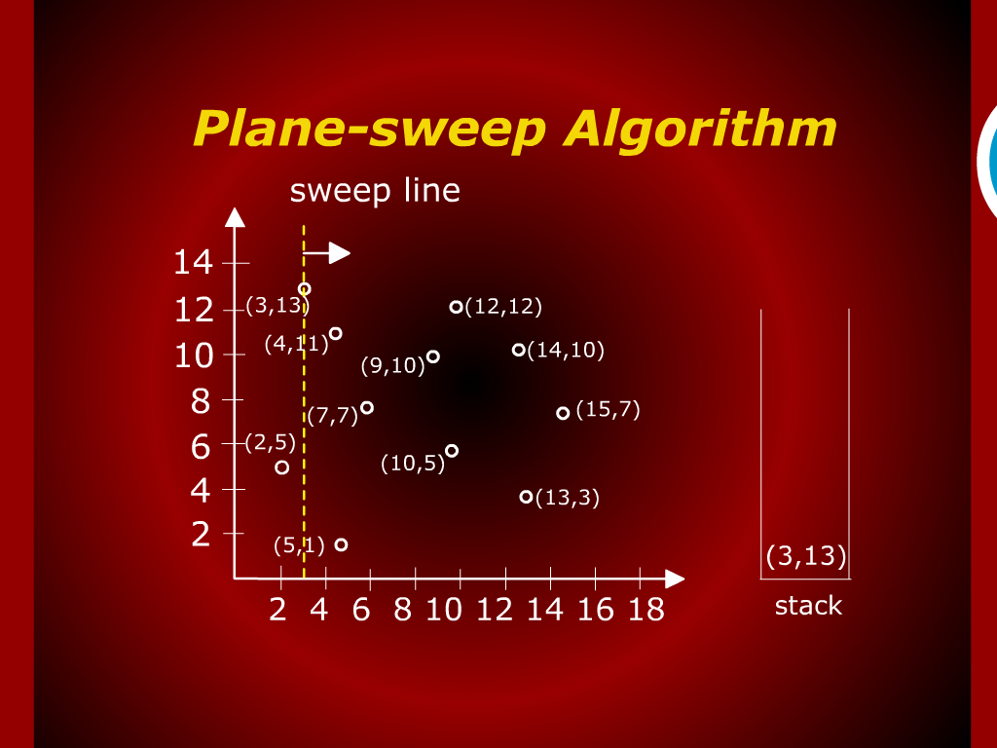
Plane-sweep Algorithm

Slide 21
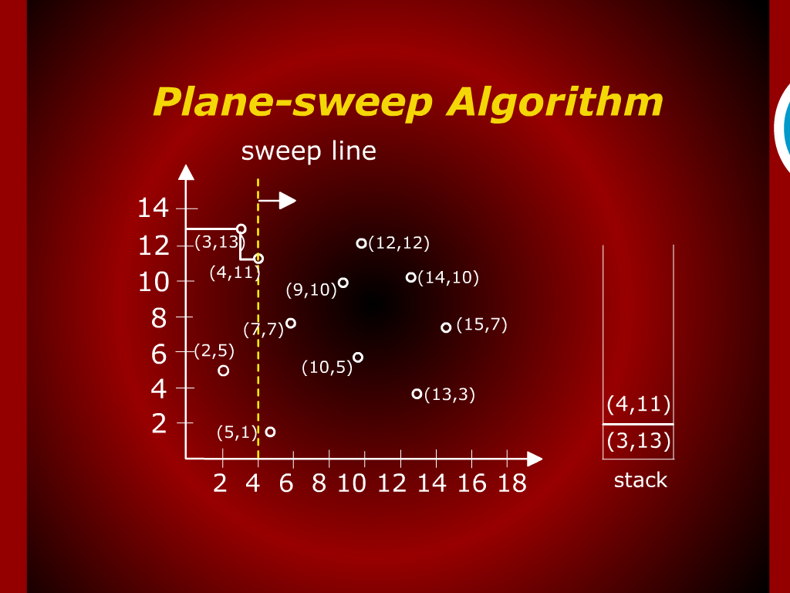
Plane-sweep Algorithm

Slide 22
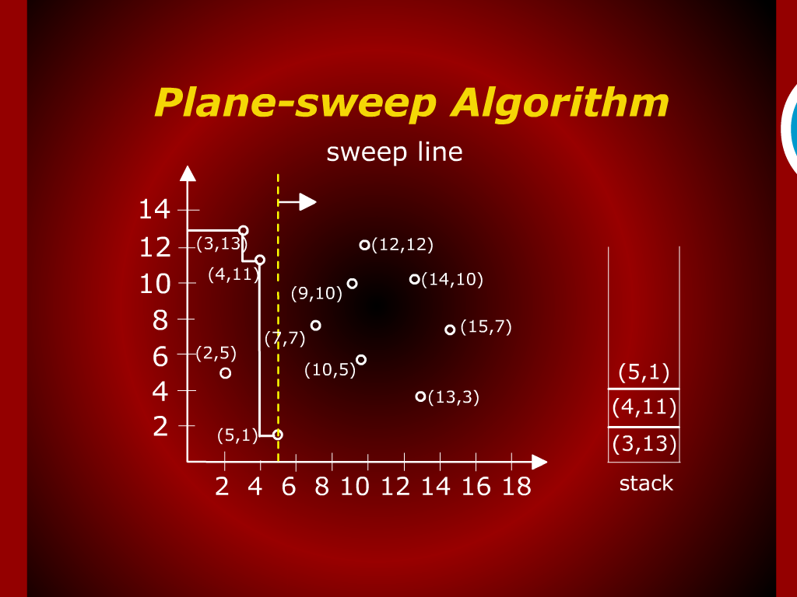
Plane-sweep Algorithm

Slide 23
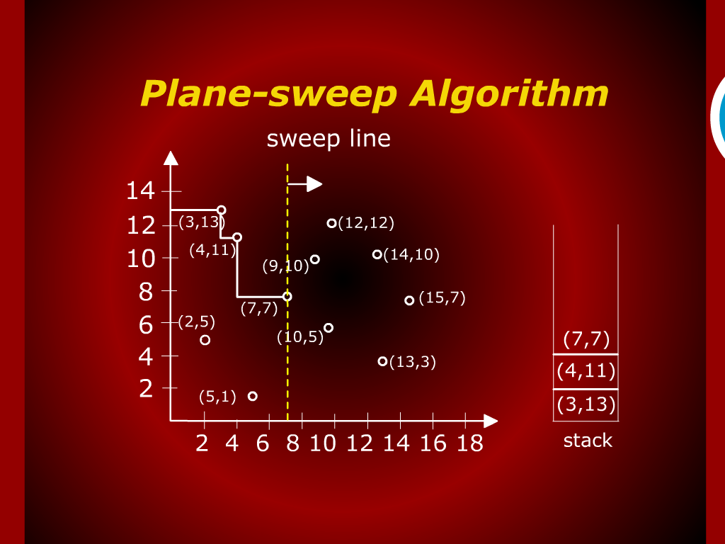
Plane-sweep Algorithm

Slide 24
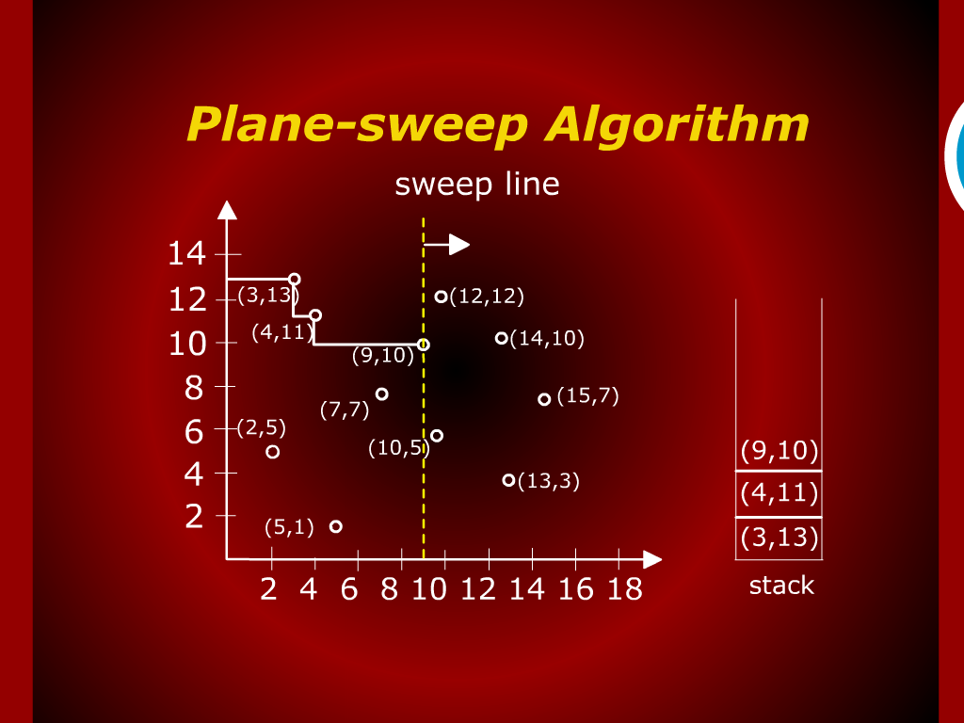
Plane-sweep Algorithm

Slide 25
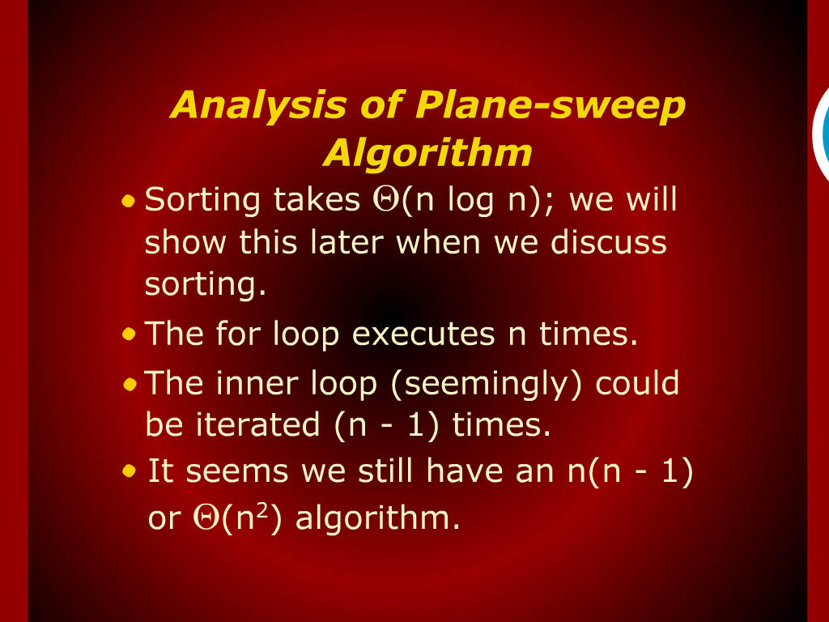
Analysis of Plane-sweep Algorithm

Slide 26
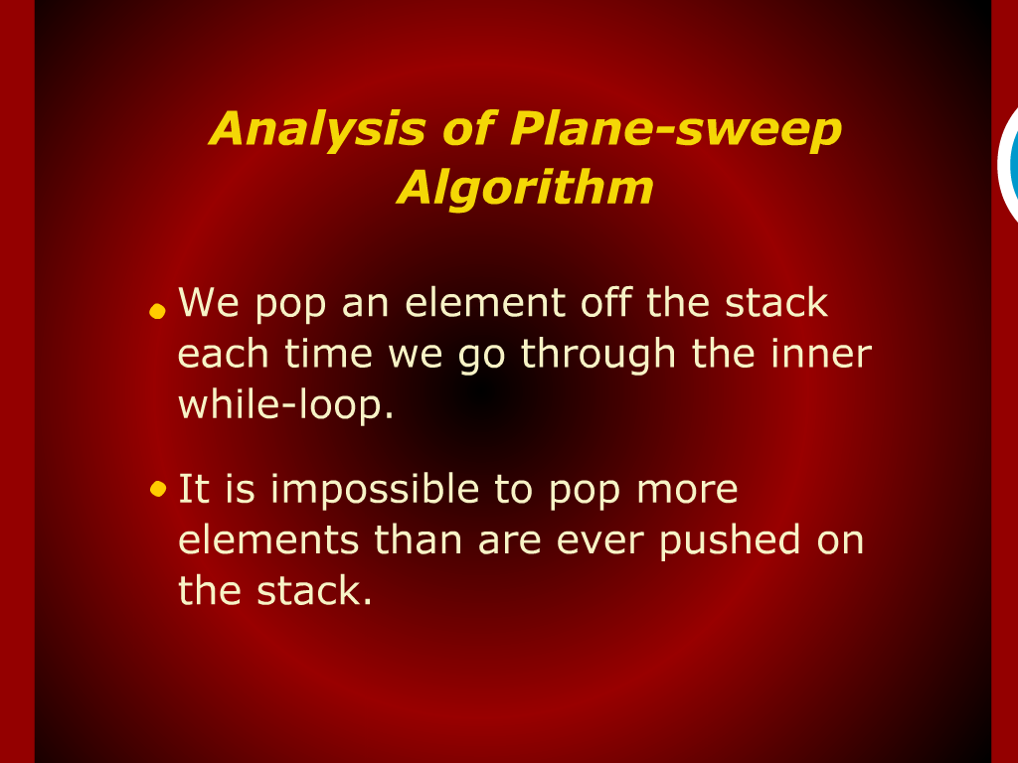
Analysis of Plane-sweep Algorithm

Slide 27
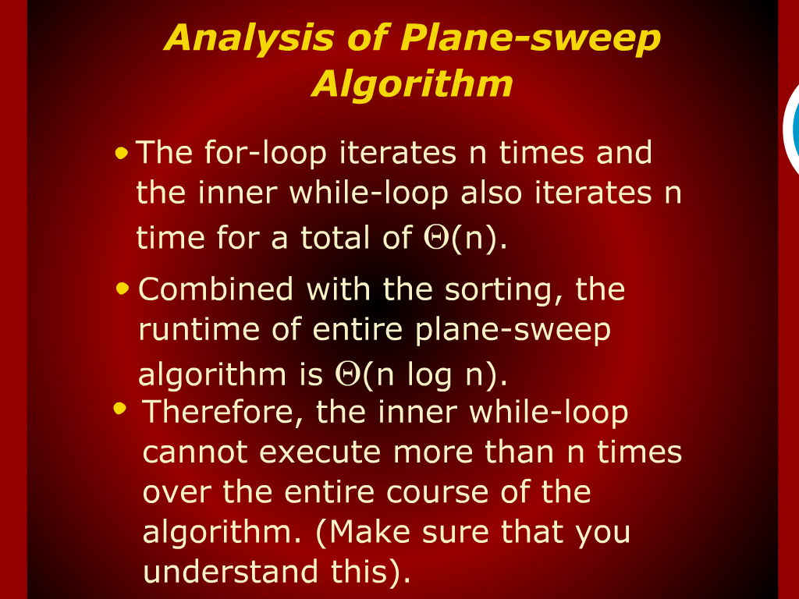
Analysis of Plane-sweep Algorithm

Slide 28
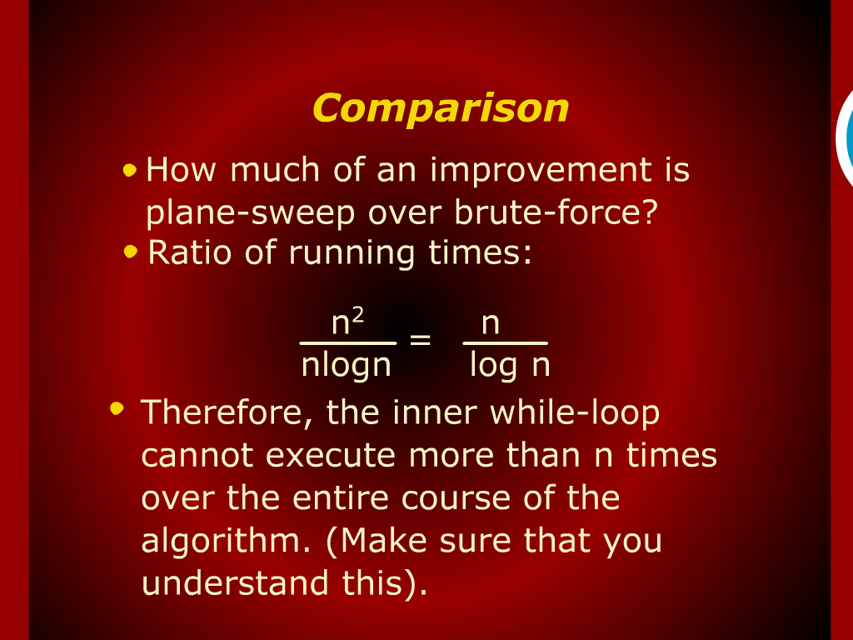
Comparison

Slide 29
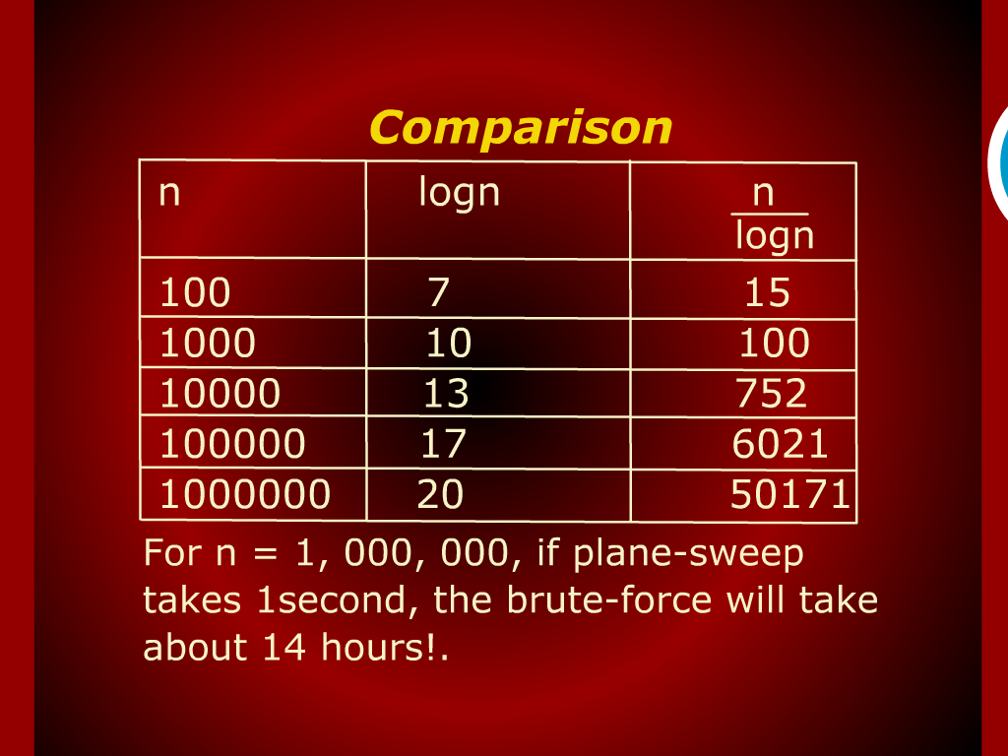
Comparison

Slide 30
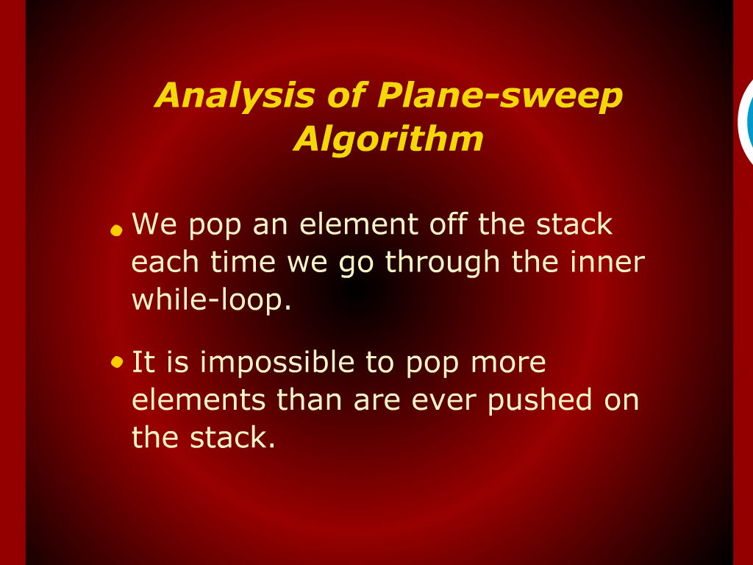
Analysis of Plane-sweep Algorithm

Slide 31
Design & Analysis of Algorithms

Slide 32
2-Dimension Maxima Revisited

Slide 33
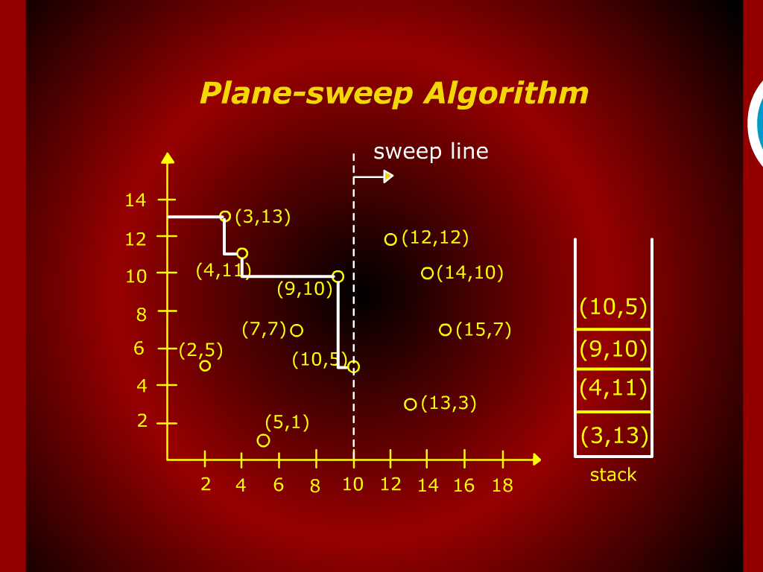
Plane-sweep Algorithm

Slide 34
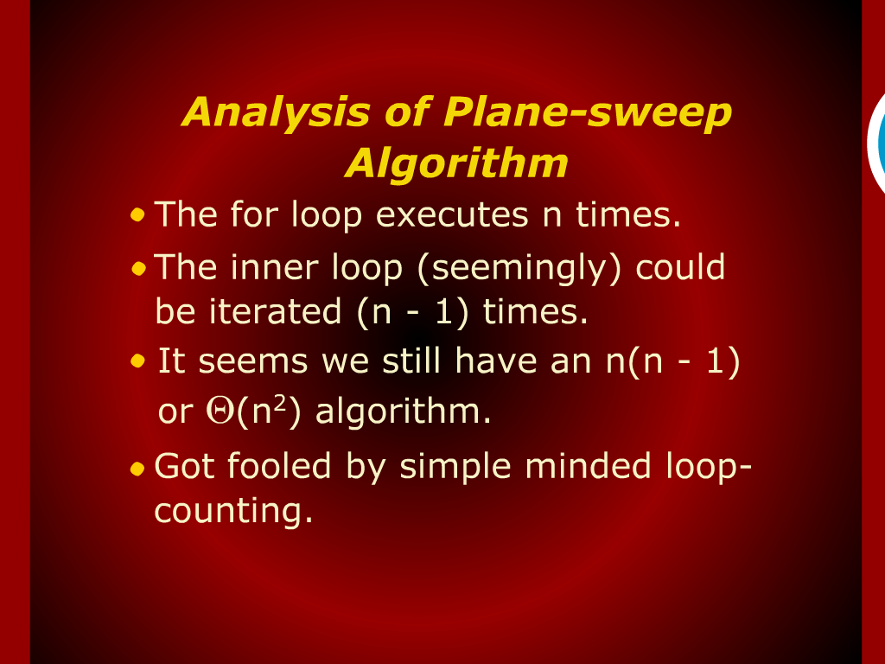
Analysis of Plane-sweep Algorithm

Slide 35
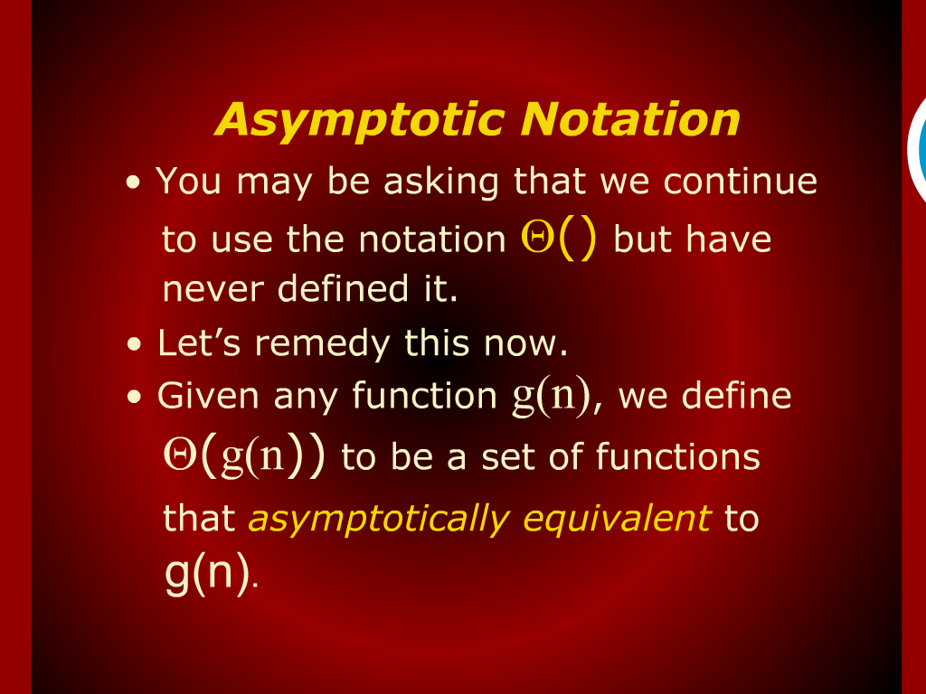
Asymptotic Notation

Slide 36
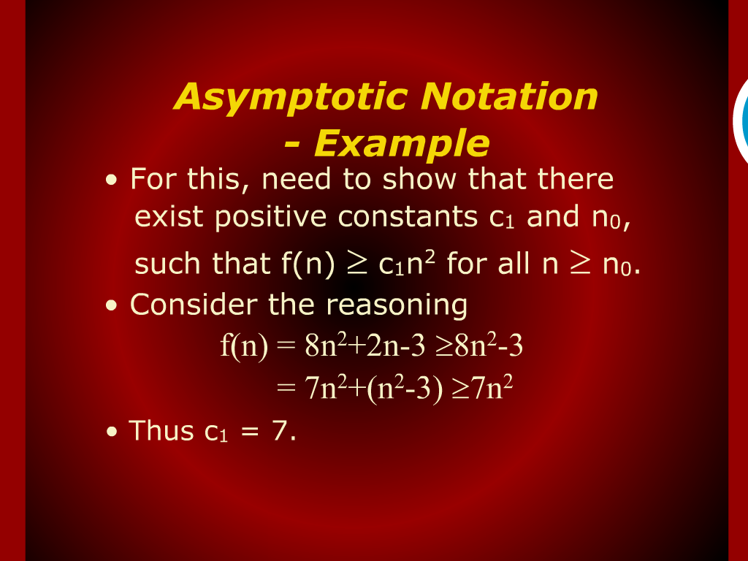
Asymptotic Notation- Example

